Slide 1

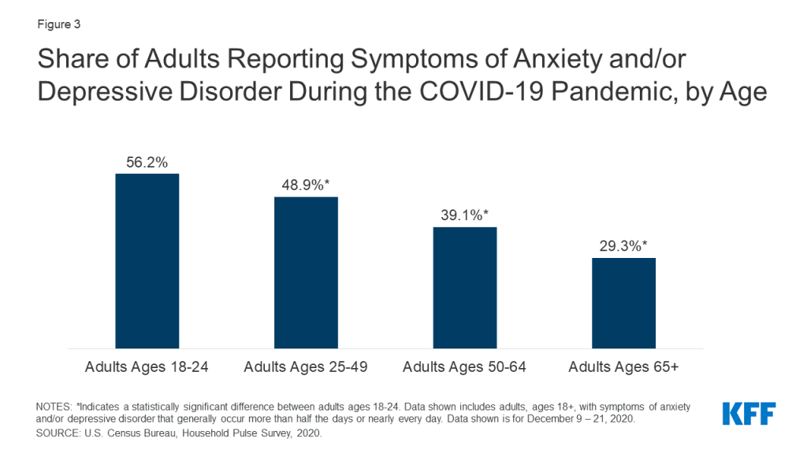
PROBLEM
Mental Health Issues have been on the rise among adolescents, young adults and a variety of age groups.
In today's world there is a definite need to stretch more on mental problems than physical and spiritual problems.
The COVID-19 pandemic has disrupted or halted critical mental health services in 93% of countries worldwide while the demand for mental health is increasing, according to a new WHO survey.
The pandemic and the resulting economic recession have negatively affected many people’s mental health and created new barriers for people already suffering from mental illness and substance use disorders.
We cannot turn a blind eye and have to find a way to combat this drastic situation we are facing or else the number of people under the grip of depression and other mental health problems will increase exponentially.
Read more about the survey: https://www.who.int/news/item/05-10-2020-covid-19-disrupting-mental-health-services-in-most-countries-who-survey
“Good mental health is absolutely fundamental to overall health and well-being,

Slide 2
What our Project is about?
Why is the Website important?
Watching today’s world, the need to tackle mental health issues is understood by us. Also taking a look at the situation at hand, we need to have a solution which is online and can help people from the comfort of their homes.
There are servers and apps which can connect to doctors or prescribe medication online when it’s a physical problem. But there’s hardly a solution for mental health problems.
The most difficult part regarding mental health problems is the identification and tracing of these patients.
A majority of people find it uncomfortable to approach a psychiatrist and thus the problem remains undiagnosed.
Considering all the above factors in mind we plan to devise a website which shall help cover all the necessities required.

Slide 3
2. What will our Website provide?
A platform which will consist of
AI BoT for responding to general questions of patients.
Emotion recognition for real time gesture recognition on patients and surveying their mood.
DataBase for clients and doctors both.
It’ll be build as a web application.

Slide 4

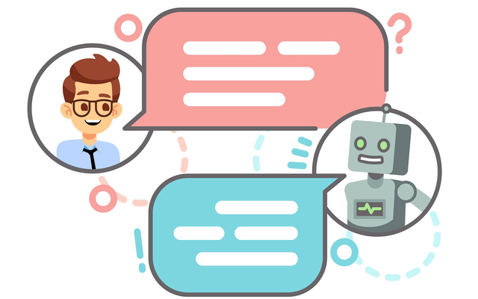
AI BOT
We will be having a bot in our application to survey the clients, whether they have problem or not. We will also be checking about what kind of problem they have and suggesting them a proper solution.
We will also be guiding the clients about how to go about the app through this bot.
This works on Automatic Speech Recognition (ASR) technology
A chatbot is an artificial intelligence (AI) software that can simulate a conversation (or a chat) with a user in natural language through messaging applications, websites, mobile apps or through the telephone.
This also works on Natural language principles such as : Natural Language Processing, Natural Language Understanding, Natural Language Generation
We will be using DialogueFlow for this.

Slide 5


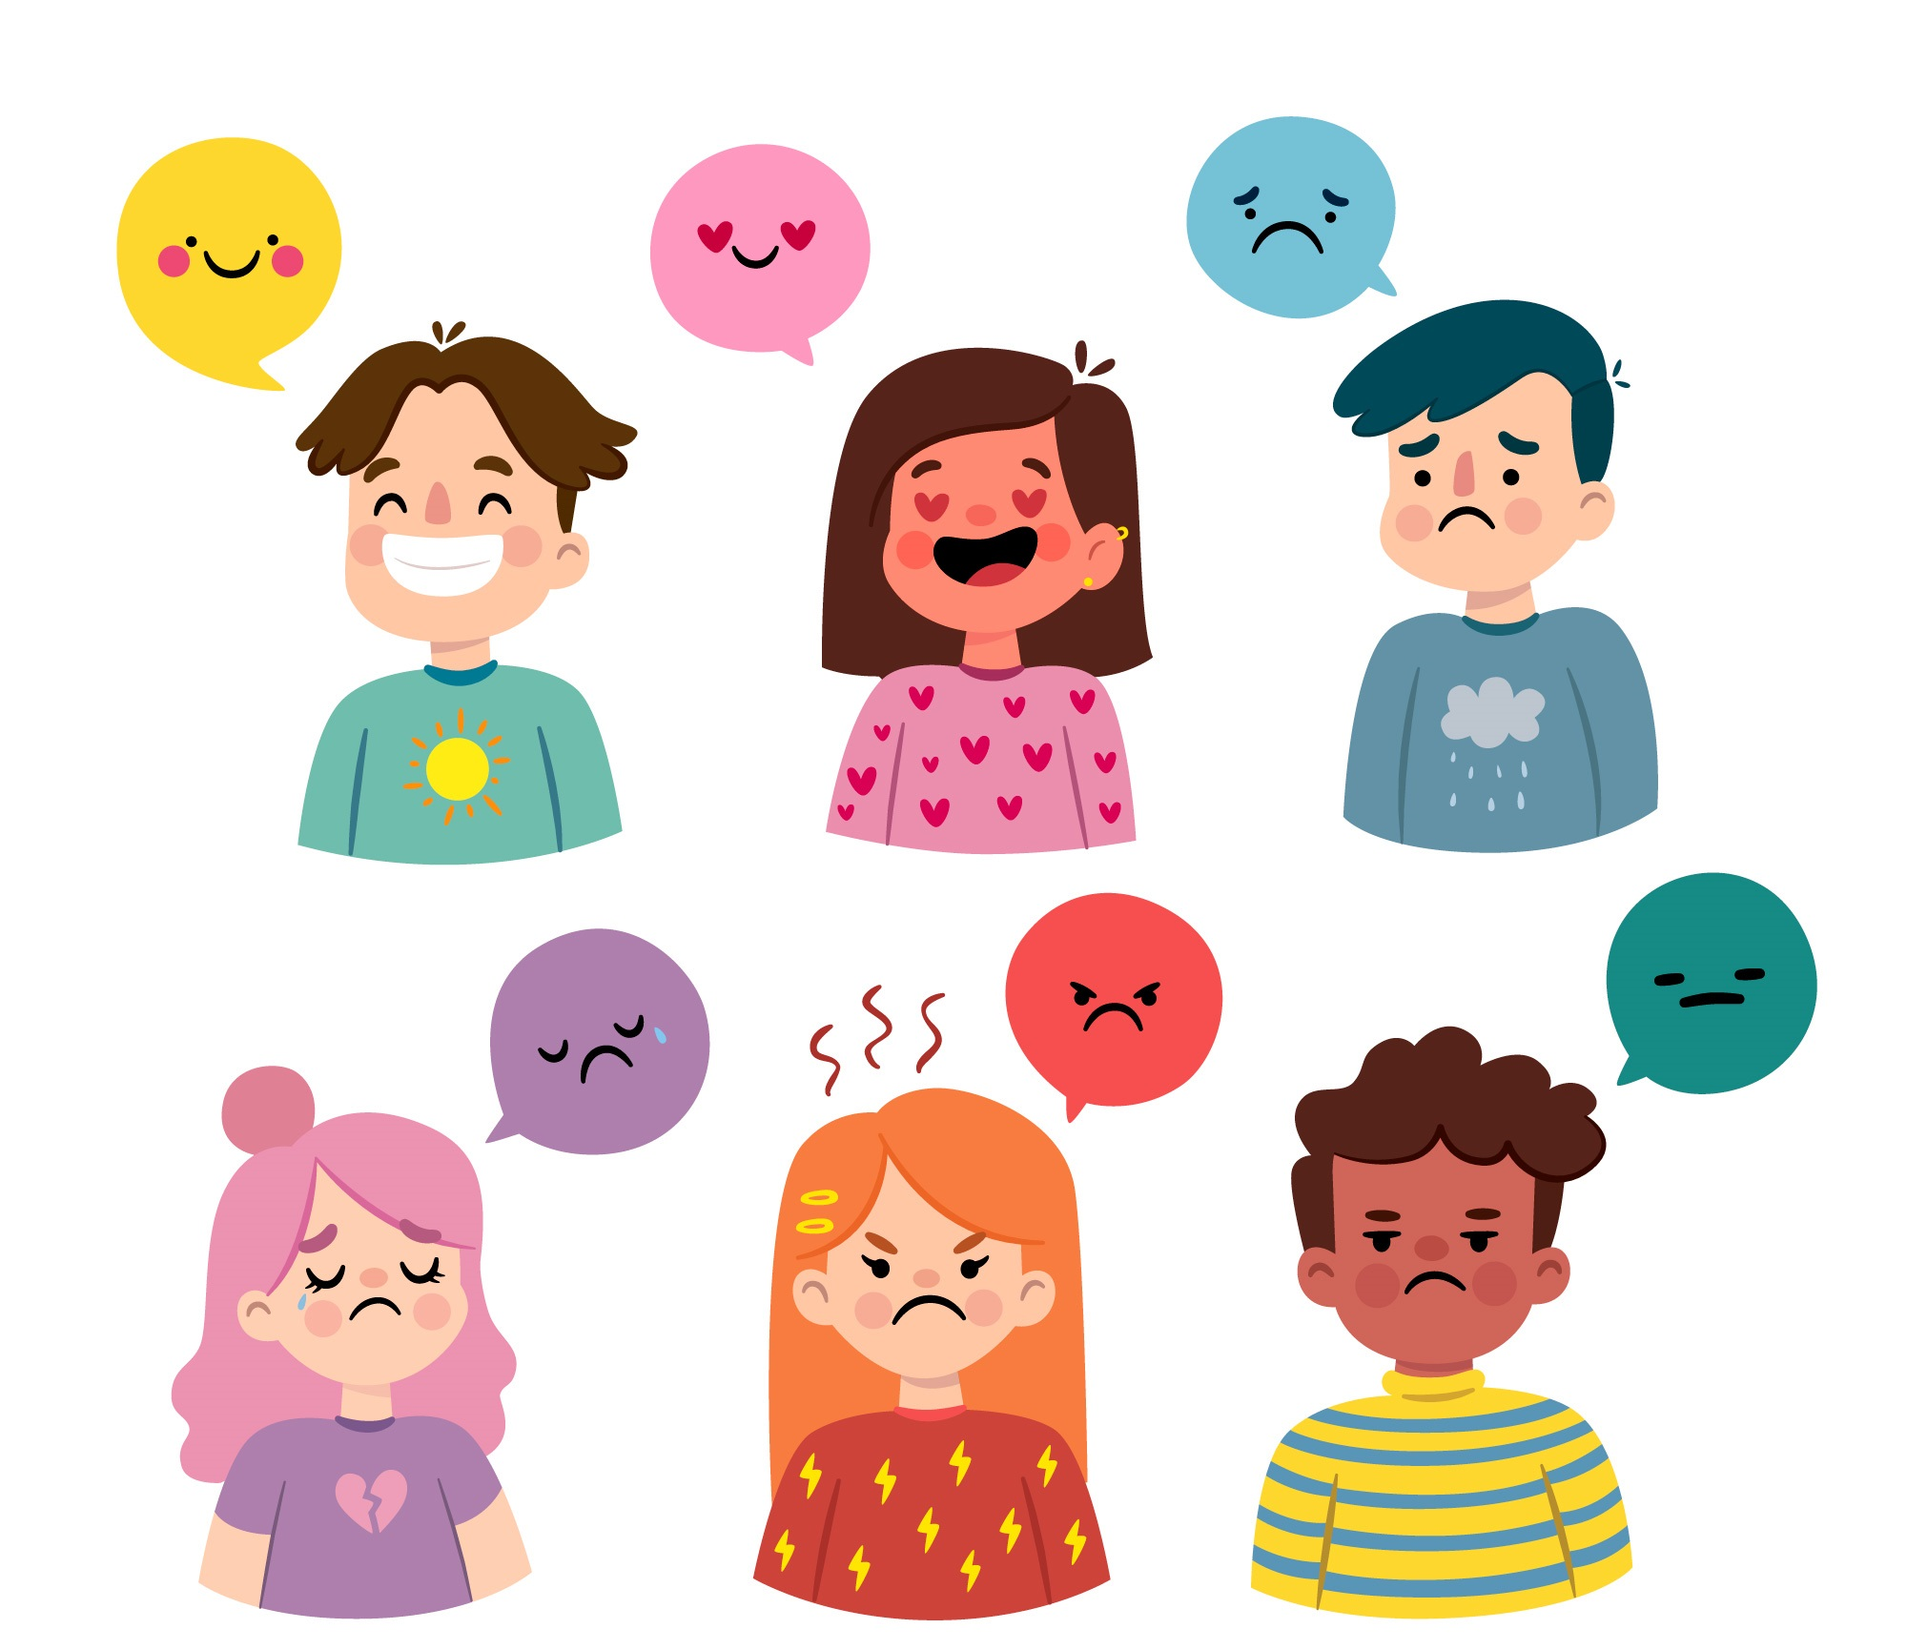
Realtime Mood Detective
Done by Altamash
We will be using Emotion recognition that uses image processing.
It will predict the emotion of the user such as: Angry, Happy, Disgust, Sad, Surprised, Fear, etc.
Its a Realtime Emotion detection so it will directly access the camera of the user and will start predicting their emotions.
We will be using same Natural Language Technologies as of AI Bot.
We will be using Face API and pretrained models for detecting expressions and landmarks
We will also be using Image Processing for the same.

Slide 6


Chat Feature
Also we will add in-build live chaTting support so that doctors and patient can have a better communication and can discuss the treatment without any hustle
Also the chatting will be end to end encrypted so there is no possibility of any data breach and the conversations remain confidential
It saves the time of patient to physically meet the doctor

Slide 7

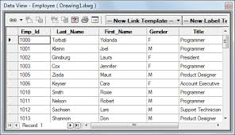

DataBase & Authentication
We will make a database to save the entry of clients.
We will also have separate entry for doctors and they will have separate access to the logbook of clients.
We will also try to keep a track of how the patients are doing.
We will also have Login Form.
Email verification link to ensure the validity of email
We are using Firebase for database and Authentication.

Slide 8
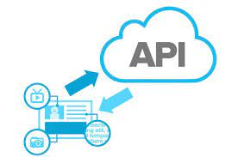

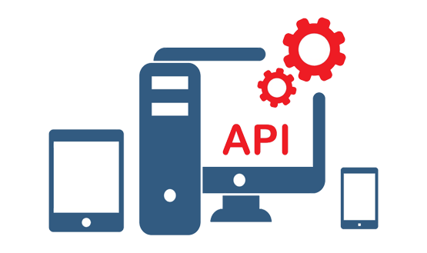
API based doctor recommedation
We will be using Geolocation API and we are also adding api based services through which can recommend docters to patients through their GPS location.
These would bring local doctors in direct contact of patients and can help patients to have variety of options of available doctors to choose from.

Slide 9

Appointment making with doctor
Brand NEW FEATURE

Slide 10
Making the website User Friendly By GUI
We will be embedding everything into a single unit on the web.
We will also try to maintain it and make user friendly, so that it is easy to use for the Users

Slide 11
Thank You
Don’t worry Shikan is there to help you !!
TEAM HELIX

